Slide 1
Assessing Climate Resiliency in Agricultural Production
MH & MP 2019 - 2023

Slide 2
Data Cleaning Strategy for climate data
Source: case_study_ds (Provided in problem statement)
Outlier Removal (IQR method)
Removed extreme values in temperature (mean, min, max) using Interquartile Range (20th–80th percentile) to avoid bias from abnormal spikes.
Gap Filling & Seasonal Smoothing
Filled missing dates to maintain continuous daily records.
Applied rolling mean smoothing and interpolation for temperature series.
Rainfall Imputation
Forward-fill and backward-fill for missing rainfall values.
Applied median smoothing to remove short-term anomalies.
District-Level Aggregation
Aggregated daily district-level medians for both temperature and rainfall.
Merged temperature and rainfall into a single cleaned dataset for each district.

Slide 3
Climate Data Analysis

Slide 4
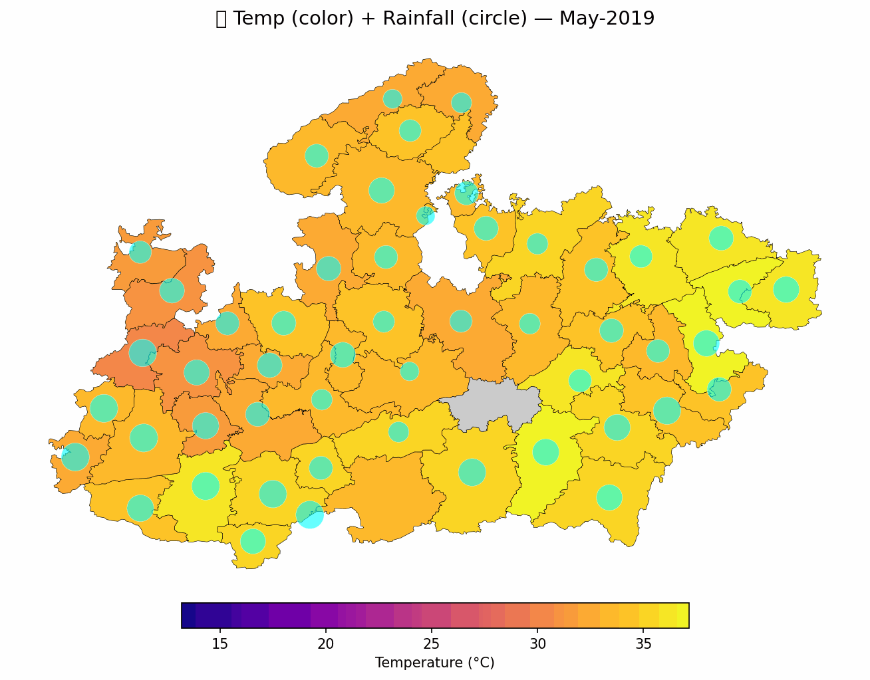
Madhya Pradesh
Animated visualization of temperature and precipitation trends (2019–2024) for Madhya pradesh highlighting fluctuations, anomalies, and emerging climate patterns.

Slide 5
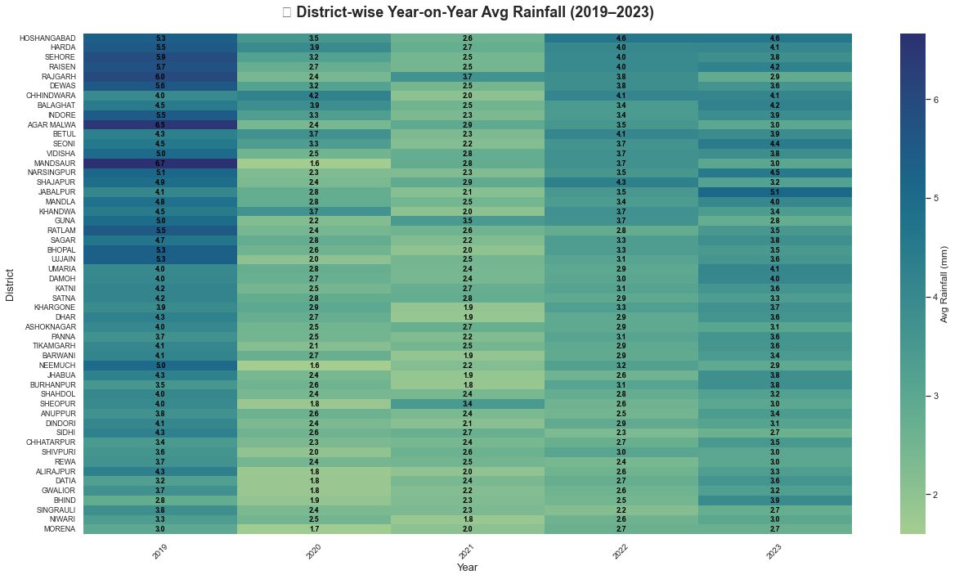

Slide 6
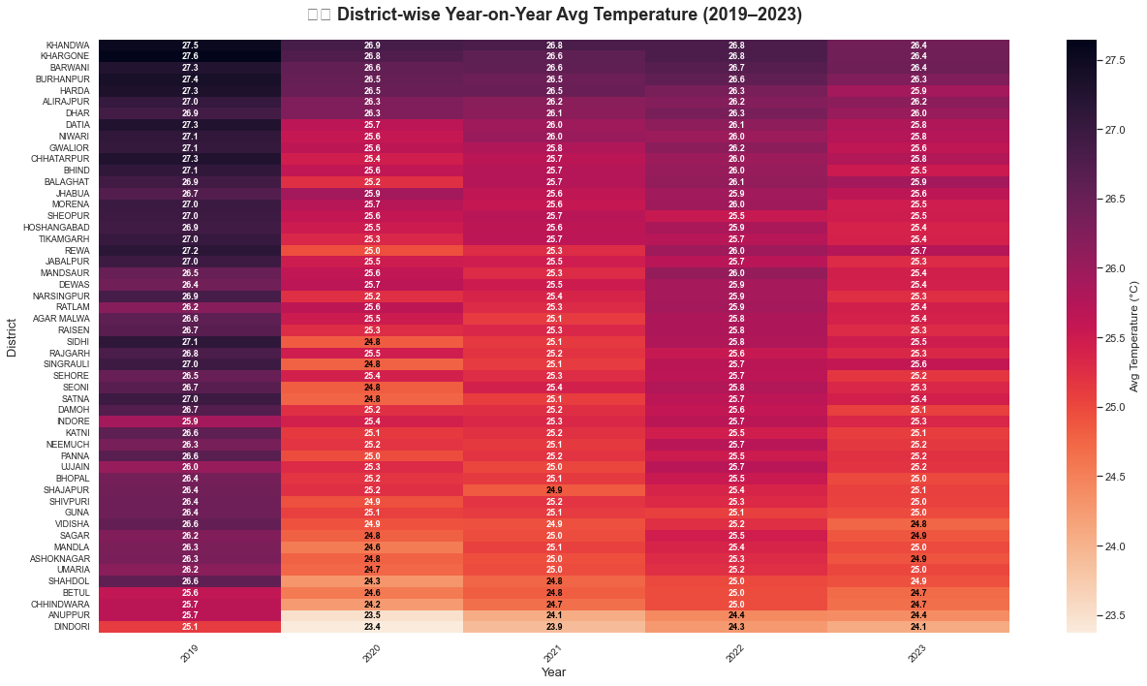

Slide 7
INSIGHTS
Temperature Variation
2019 and 2022 emerge as relatively warmer years, with multiple districts showing higher-than-average temperatures compared to surrounding years.
Districts like Bhopal, Indore, Gwalior, Jabalpur and Sagar exhibit a slight but steady increase in temperatures from 2020 to 2023.
Rainfall Trends
A sharp decline in rainfall is evident in 2021 across nearly all districts.
Districts like Balaghat and Mandla show extreme fluctuations.
Districts like Hoshangabad, Harda and Chhindwara consistently received higher rainfall (50+ mm) compared to others, even in drier years like 2021

Slide 8
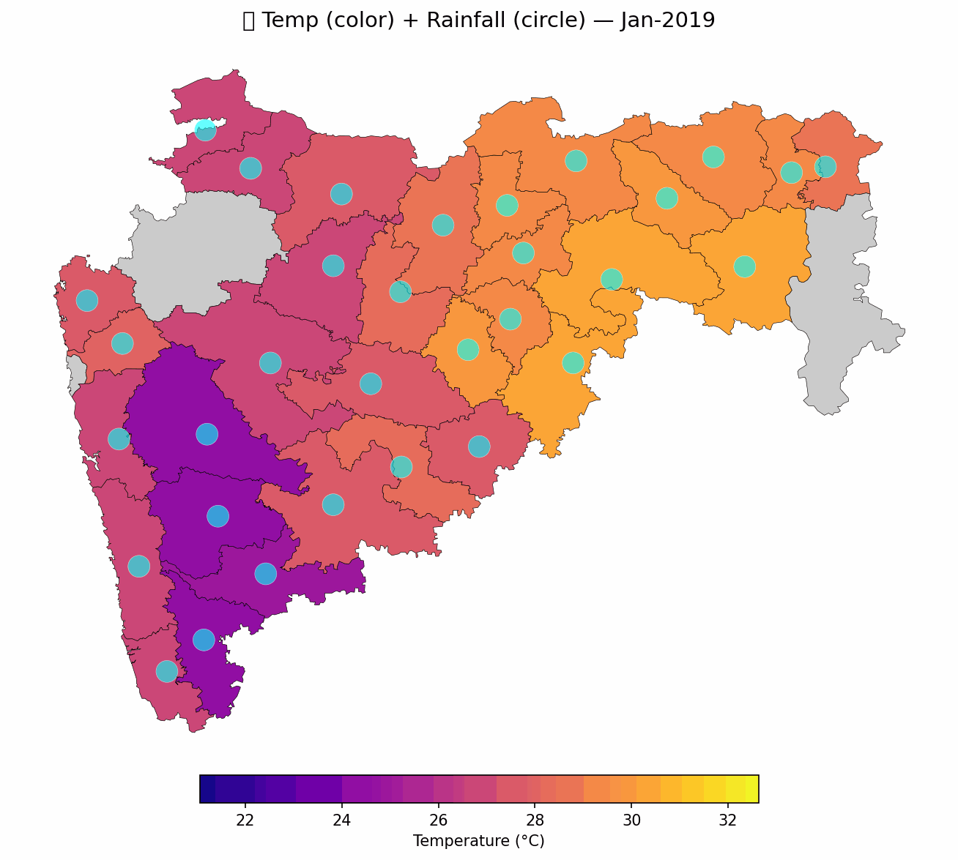
MAHARASHTRA
Animated visualization of temperature and precipitation trends (2019–2024) for Maharashtra highlighting fluctuations, anomalies, and emerging climate patterns.

Slide 9
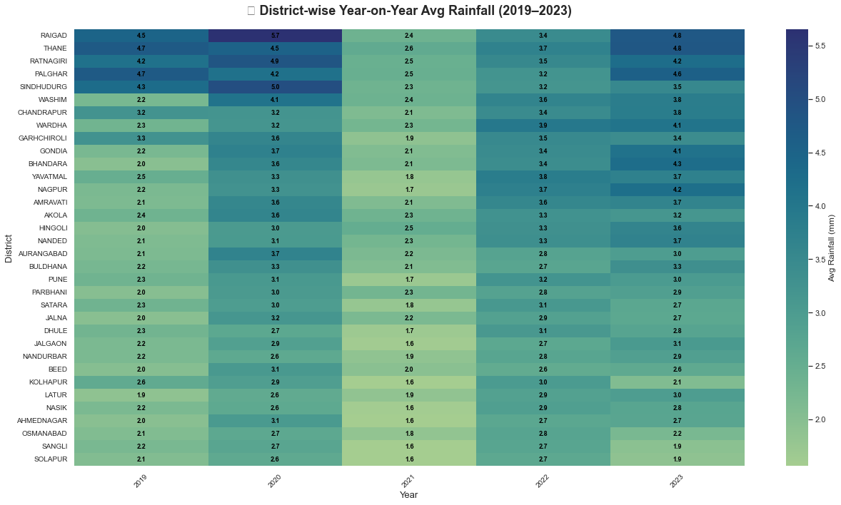

Slide 10
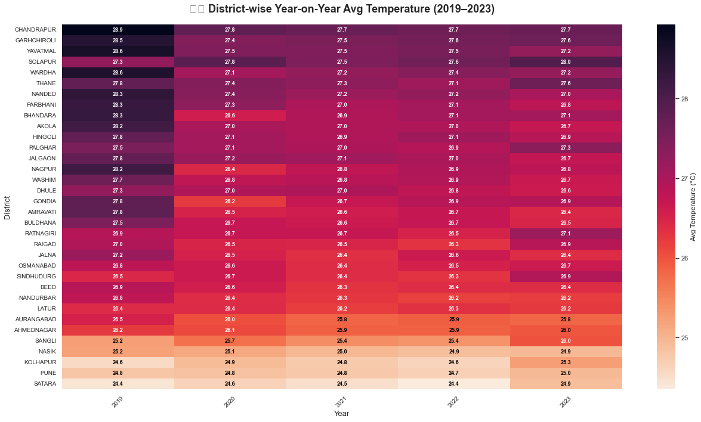

Slide 11
INSIGHTS
Temperature Variation
2019 stands out as a peak temperature year, with values higher than subsequent years.
A gradual rise in average annual temperature is visible across Solapur, Ratnagiri, Pune, Sindhudurg, and Thane over the years.
Rainfall Trends
Rainfall patterns show noticeable interannual variability, with some years experiencing significantly higher rainfall than the long-term average, particularly in districts like Ratnagiri and Sindhudurg.
A decline in annual rainfall is seen in districts such as Solapur and Kolhapur during the latter years, suggesting possible emerging dry trends.
A noticeable drop in annual rainfall is seen in 2021 across most districts, compared to preceding years.

Slide 12
CROP PERFORMANCE ANALYSIS

Slide 13
Data Cleaning Strategy
Data Source
NDVI data obtained from MODIS MOD13Q1 satellite product via Google Earth Engine (GEE).
NDVI (Normalized Difference Vegetation Index) is a reliable proxy to assess vegetation health and crop vigor.
Seasonal Classification
Crop seasons split into Kharif (June–September) and Rabi (October–March) to align with regional cropping calendars.
Handling Missing Data
Missing NDVI values due to data gaps were imputed using a Random Forest regression model trained on available NDVI and climate features.
Seasonal and Monthly Aggregation
NDVI and climate data were aggregated at monthly and seasonal scales to capture relevant trends.
Anomaly Calculation
NDVI anomalies were calculated by subtracting long-term baseline NDVI averages from observed values to highlight deviations linked to climate or crop stress.

Slide 14
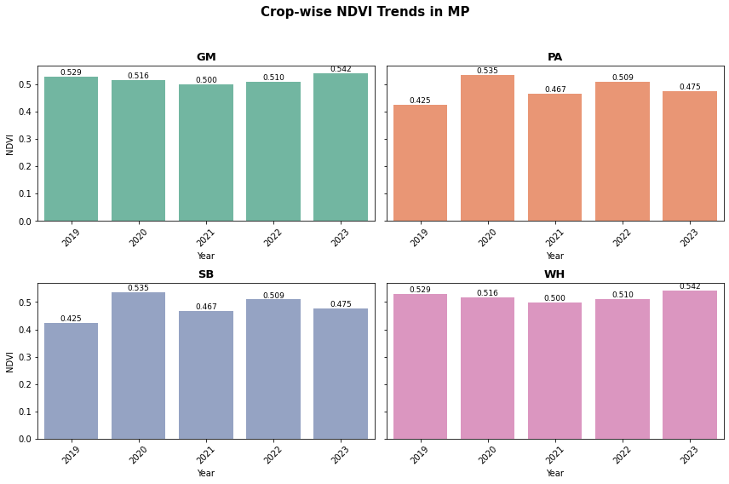
In 2019, with higher temperature and rainfall, SB and PA showed lower NDVI, while GM and WH remained more resilient with higher NDVI.

Slide 15
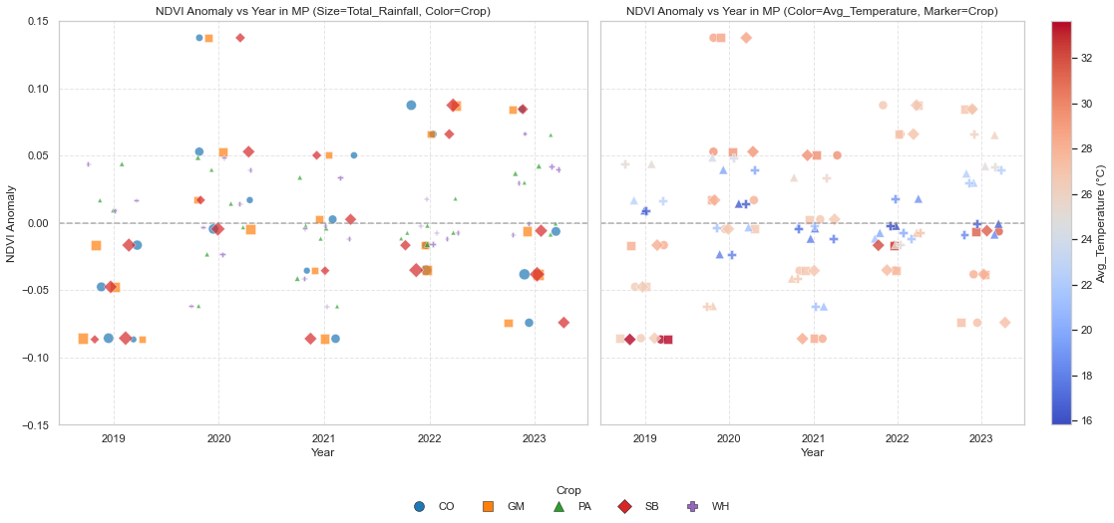
High rainfall suggests excessive rainfall might have been harmful
High average temperatures suggests heat is a major stress factor.
Wheat (WH) and Gram (GM) appear to be more resilient to climate fluctuations than crops like Soybean (SB), Paddy (PA), and Cotton (CO)

Slide 16
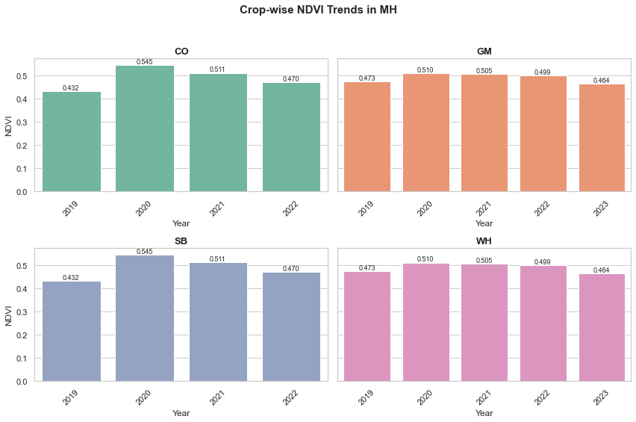
In 2019, with higher temperature and rainfall, SB and PA showed lower NDVI, while GM and WH remained more resilient with higher NDVI.

Slide 17
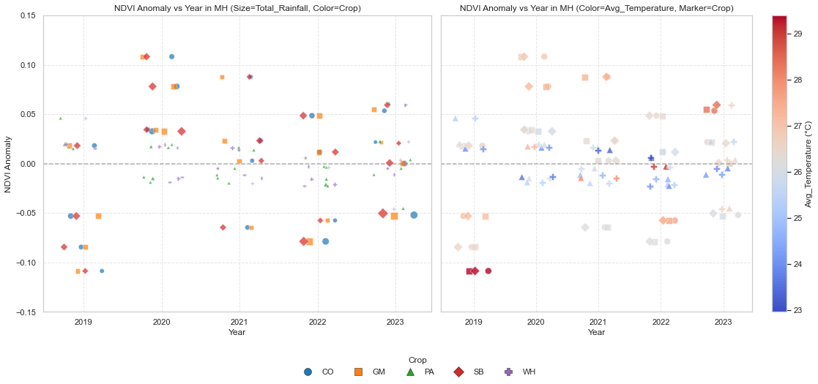
*Observations similar to MP
The overall pattern of a challenging 2019, a more favorable 2020, and a mixed period afterward is repeated in the data for Maharashtra.

Slide 18
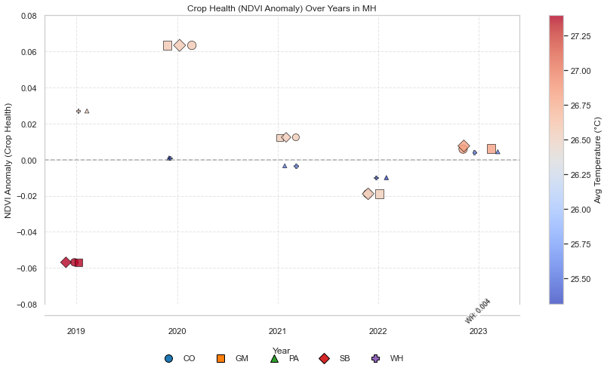
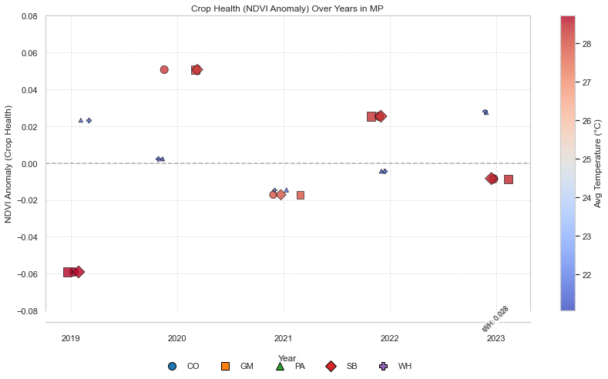
Both Maharashtra and Madhya Pradesh experienced a significant and similar drop in crop health during 2019, indicating a shared vulnerability to that year's climate conditions.
While Madhya Pradesh crops showed signs of recovery and stability in later years, Maharashtra's crops seemed to face more consistent stress

Slide 19
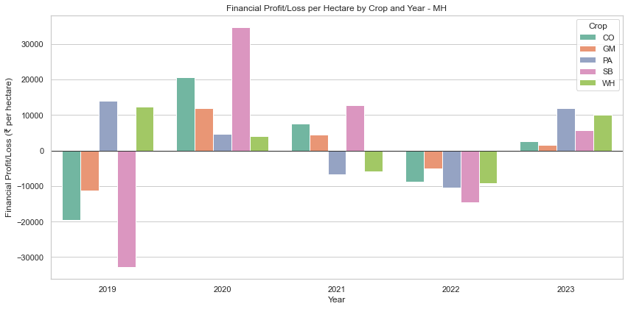
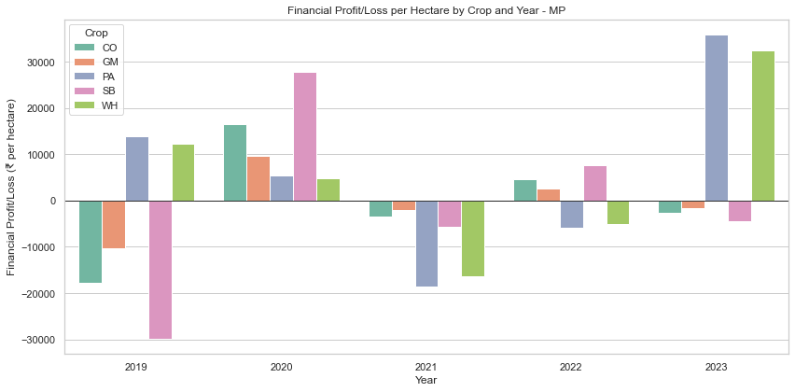
The profits and losses for different crops vary wildly year-to-year
Both states experienced widespread losses in 2019, with nearly all crops showing a negative financial impact.
Profits and losses for certain crops are more predictable. Crops like Paddy and Wheat consistently show significant profits in good years, such as 2020 and 2023.

Slide 20
Infrastructure and Technology Assessment
Farmers can be informed about rain and heat for their area. This lets them change their plans, like when to plant or pick crops, to avoid big losses from bad weather.
Tools like satellites and drones let farmers check on crop health and soil moisture from a distance. This helps them know exactly where to apply water or fertilizer, which saves money and leads to better harvests.
Advanced water management systems help farmers grow crops even when rainfall is low. They work by using water more efficiently, delivering it right to the plant's roots and ensuring that crops have enough to survive dry periods.

Slide 21
Government Policies and Support Programs
Crop Insurance (PMFBY): This plan pays farmers when they lose crops to natural disasters. It's meant to protect them financially, but some farmers find it hard to enroll, and payments can be slow.
Water Management (PMKSY): This program helps farmers get water to their fields by promoting new irrigation systems. It works well where it's used, but not all farmers know about it or have access to it.
Sustainable Farming (NMSA): This initiative supports research and better farming methods to help farms handle climate change. Its goals are good, but it's often a long-term effort, so it's hard to see immediate results.
Minimum Price Guarantee (MSP): This policy guarantees a basic price for a few crops, giving farmers a stable income. It helps them feel more secure, but it doesn't cover all crops and isn't available to every farmer.

Slide 22
Recommendations
Early Warning Systems
Enhance weather and satellite data systems to send farmers real-time alerts for climate risks like heat waves. This will allow them to take proactive measures, minimizing crop damage and financial loss.
Promote Resilient Crops
Encourage farmers to plant crops like Wheat and Gram, which show more stable performance and resilience to climate stress, while reducing their reliance on more susceptible crops like Soybean and Cotton, especially in volatile regions like Maharashtra.
Reform Government Policies
Streamline government support programs, such as crop insurance and water management schemes, to make them more accessible and effective for all farmers, ensuring they can better recover from climate shocks.

